Slide 1
Utilization potential of free available biomass in Mecklenburg-Western Pomerania
Editor: Sebastian Foth
Department for Waste and Resource Management

Slide 2
Free available biomass
Landscape management material (LMM)
Water care material/water maintenance cutting material (WCM)
Treibsel / Beach Wrack

Slide 3
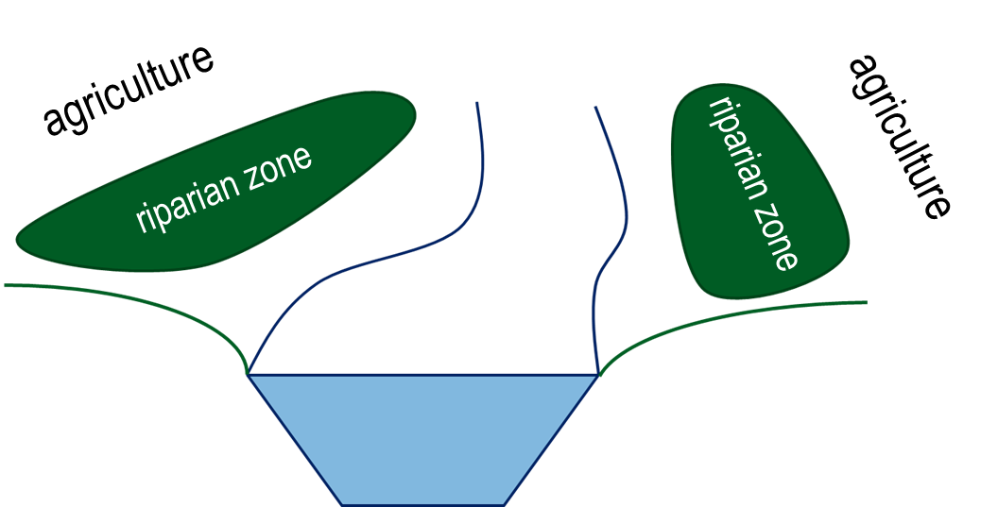
Landscape management material (LMM)

Slide 4
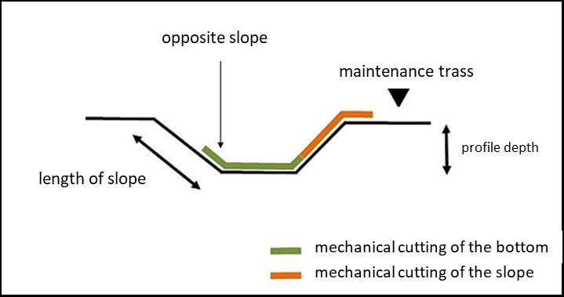
Water care material (WCM)

Slide 5
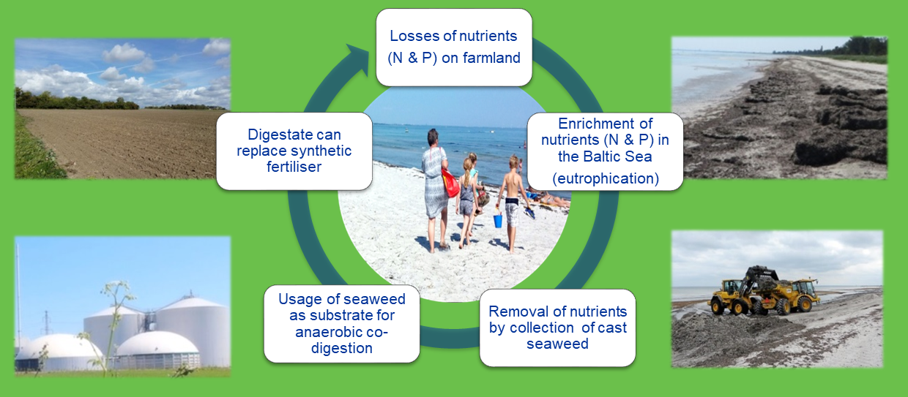
Treibsel / Beach wrack
Losses of nutrients (N & P) on farmland
Products of conversion can replace synthetic ferilizers
Enrichment of nutrients (N & P) in the Baltic Sea (eutrophication)
Usage of Treibsel as substrate for different usage paths
Removal of nutrients by collection of cast Treibsel

Slide 6
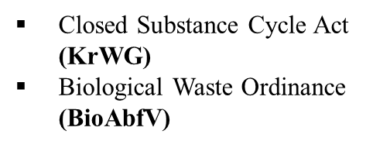
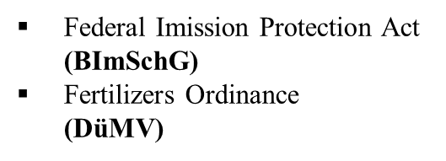
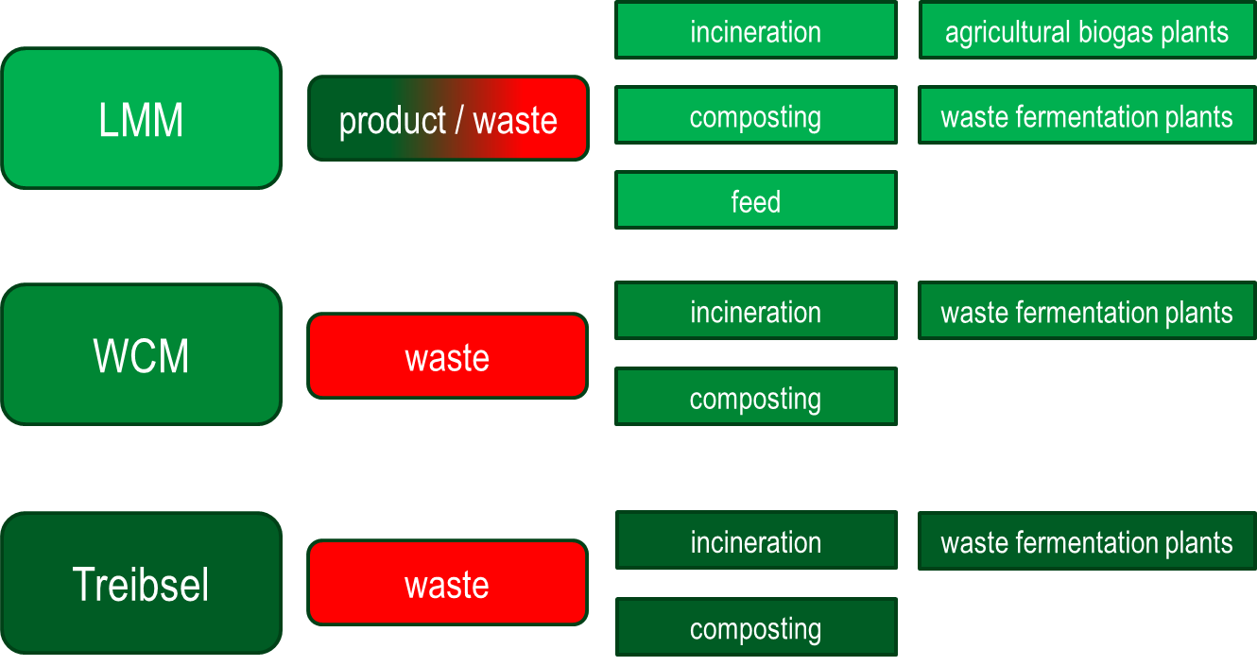
Legal Framework

Slide 7

Theoretical potential of free available biomass
Landscape management material (LMM)
area: 18.000 ha
dry mass: 5,5 t/ha
> 99.000 t
18.000 km
5 m
5 m

Slide 8

Theoretical potential of free available biomass
Water care material/water maintenance cutting material (WCM)
area: 18.000 ha
dry mass: 5,5 t/ha
> 99.000 t
area: 9.000 ha
dry mass: 4 t/ha
> 36.000 t
18.000 km
5 m

Slide 9
Theoretical potential of free available biomass
Treibsel / Beach Wrack
area: 18.000 ha
dry mass: 5,5 t/ha
> 99.000 t
area: 9.000 ha
dry mass: 4 t/ha
> 36.000 t
dry mass:
> 5.000 t
350 km

Slide 10
Theoretical potential of free available biomass
> 5.000 t
> 36.000 t
> 99.000 t
> 140.000 t

Slide 11
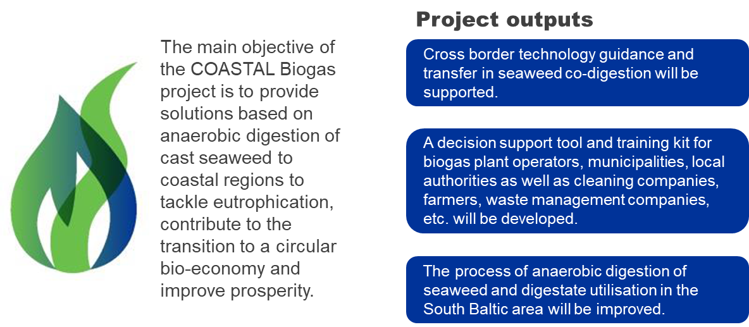
COASTAL Biogas

Slide 12
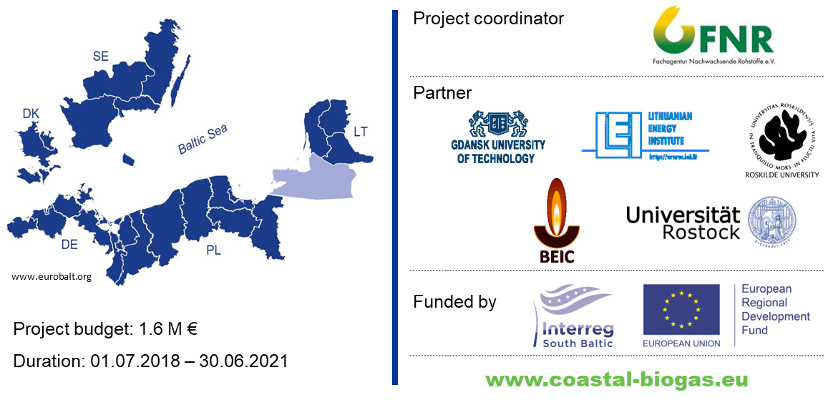
COASTAL Biogas

Slide 13

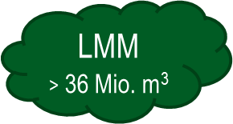
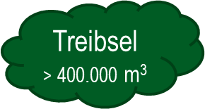
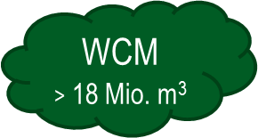
Technical potential of free available biomass
510 biogas plants
29 composting plants
1 waste incineration plant

Slide 14
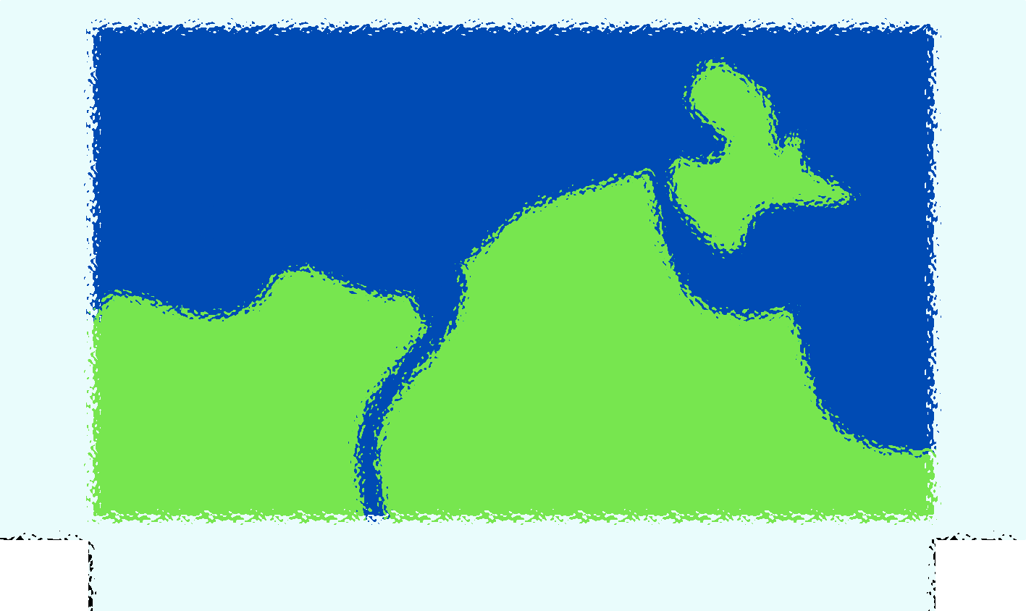
Thank you very much for your attention !

